Slide 1
SMART TRAFFIC MANAGEMENT SYSTEM
USING ARDUINO AND RFID TAGS
Abstract - Traffic congestion is becoming a grave problem in many big cities of the country. Unpredictable failure of traffic signals, poor law enforcement and bad traffic management has led to this grave problem of traffic congestion. The road traffic management strategy determines the objectives, roles, responsibilities and operational principles of Regional Transport Office (RTO). The main aim of this project is to provide a smart way to monitor and control traffic congestion on roads and emergency service vehicles. The appropriate places for placing radio frequency readers are selected so that the radio frequency tags on ambulance and fire-extinguisher truck can be read easily by the reader. This project will improve the current traffic system. To control traffic, some corrective measures are taken that are implemented in our system. In the proposed system, there will be barricades placed before zebra crossing lines so that vehicles will stop behind it systematically and nobody will be able to break the signal and go, thus, reducing number of accidents. This will ensure safety of all the pedestrians and all drivers. In this system, the emergency services like ambulance vehicle and fire-extinguisher truck are also given priority to reach their destination in time, thus reducing delay. The proposed system is designed to accept information about any emergency cases such as the passing of president, or any other VIP persons, ambulances, or fire extinguisher trucks using radio frequency identification technology. For implementation, we are using one Arduino-UNO and one Arduino-MEGA board and RFID technology. The system has the ability to open a complete lane for such emergency cases. As a result, the system will guarantee the fluency of traffic for the main vital streets and paths that require fluent traffic during peak hours of the day and the traffic density.
Index Terms - traffic, traffic control, barricades, signals, ambulance, fire brigade, traffic congestion, accidents, RFID technology, Arduino Mega, Arduino Uno, etc.
I. INTRODUCTION
A. About traffic management
It has become very easy for a common person to own a vehicle with
affordability and higher purchasing power. It creates a problem in terms of road congestion and increasing traffic in big cities though this has led to
comfortable lifestyles. Smart traffic management system is an alternative way to solve road traffic problem and this system will support existing operation system. Traffic congestion is a severe problem in almost every modern cities around the world. Traffic congestion has been causing many critical problems and
challenges in the major and most populated cities. It is becoming more difficult and
time-consuming to travel to different places within the city. Due to these
congestion problems, people lose time, miss opportunities, and get frustrated. Due to traffic congestion, there is a loss in productivity from workers, trade opportunities are lost, delivery gets delayed, and thereby the costs goes on increasing.

Slide 2
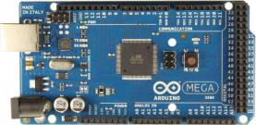
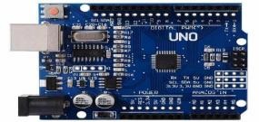
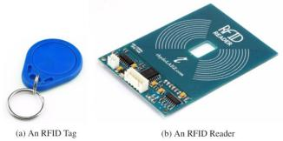
B.
Role of Arduino in the project
In this project, we have used one Arduino MEGA where all the four LEDs (as signals) and eight servo motors (a pair for each road) acts as barricades connected to it to handle the traffic in a road junction and one Arduino UNO board where all the four RFID readers are connected to it. Also both MEGA and UNO boards are connected to each other with the help of jumper wires to form a circuit.
Let us consider a four number of roads (R1, R2, R3 and R4) to form a road junction. Now, for road R1, there will be two barricades for each lane (left and right lane), a signal, and RFID reader. This is applicable to all the remaining roads, i. e., R2, R3 and R4. When the signal for road R1 becomes green, the barricades of both the lanes will be up (open) , the signals for roads R2, R3 and R4 becomes red and the barricades of those respective lanes will be down (closed) so that no vehicles can break the signal and also it will help to reduce traffic congestion and number of accidents. Now, after a particular time, the signal of road R1 turns yellow and then red so that the barricades of the road will be closed and again no vehicles can break the signal. Also, signal for road R2 becomes green and the barricades of that road will be opened. This operation will be continued for all the remaining roads.
Now, for example, if any emergency vehicle comes on the road R3 (which has the red signal) and if suppose the road R1 has green signal, then the RFID reader placed on road R3 detects the tag which is placed on the emergency vehicle (saved in the program) which turns the signal for road R1 to red (barricades will be closed) and R3 to green (barricades will be opened), so that the emergency vehicle will be passed without any obstacle. This operation will be performed for all the roads, from where the emergency vehicle is coming from.
Figure 1(a): Arduino MEGA
C. Role of RFID in the project
Figure 1(b): Arduino UNO
This project will apply the Radio Frequency Identification (RFID) technology to scan and read the radio frequency tag placed on the emergency vehicles at road junction. This system has a potential to replace a manual inspection process of the police which is also another cause of the traffic jam. In this project, we have introduced radio frequency based vehicular system. An radio frequency receiver and transmitter are used to receive and transmit the information from the emergency vehicles to the signal points. Radio frequency technique deals with multi-lane multi-junction areas. The use of radio frequency distinguishes between the emergency service vehicles and rest traffic, thus preventing the unnecessary traffic congestion. The communication is done through the transceiver and receiver and the system is fully automated and there is less need of human intervention. For manual operation, remotes are also provided through which barricades will be opened if required. There will be additional hardware of Servo Motors which be placed on the barricades by which the barricades will be opened.
II. PROBLEM DESCRIPTION
A. Existing Problem
It has become very easy for common man to own a vehicle with affordability and higher purchasing power. It creates a problem in terms of road congestion and increasing traffic in big cities though this has led to comfortable lifestyles. Smart traffic management system is an alternative way to solve road traffic problem and this system will support existing operation system. Traffic congestion is a severe problem in almost every modern cities around the world. Traffic congestion has been causing

Slide 3
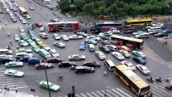
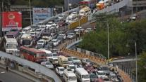
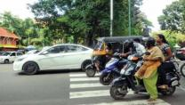
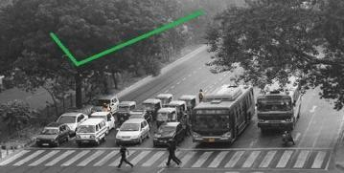
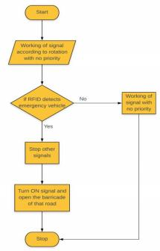
many critical problems and challenges in the major and most populated cities. It is becoming more difficult and time-consuming to travel to different places within the city. Due to these congestion problems, people lose time, miss opportunities, and get frustrated. Due to traffic congestion, there is a loss in productivity from workers, trade opportunities are lost, delivery gets delayed, and thereby the costs goes on increasing. Also, sometimes because of heavy traffic, emergency vehicles remain stuck in the traffic and hence cannot reach their destination in time.
Figure 3(a): breaking of signals
Figure 3(b): traffic congestion
Figure 3(c): disobeying of traffic rules
B. Purpose
The purpose of this project is to increase awareness of people regarding obeying of traffic rules, to reduce the traffic
congestion, to reduce the delay for emergency vehicles to reach their destination and to reduce number of accidents due to violation of traffic rules which may sometimes prove to be fatal.
Figure 4: Obeying of traffic rules due to our system
C. Scope
The project can be implemented for three lane as well as four lane roads. We can also use IOT (Internet of Things) in this project. The traffic density estimation can be evaluated and the signal timer for that road can be set accordingly. It can be used for the detection of stolen vehicles.
D. Flowchart
Figure 5: Flow-chart representation of our system

Slide 4
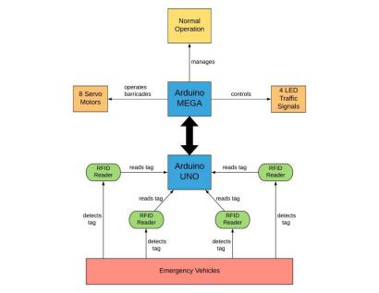
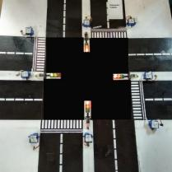
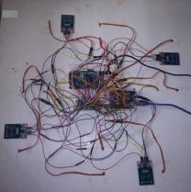
III. RESEARCH METHODOLOGY
A. Architectural Block Diagram
The block diagram contains one Arduino UNO and one Arduino MEGA board connected to each other where all the four RFID readers are connected to UNO board. This RFID reader on roadside detects and scans the RFID tags placed on the emergency service vehicles. This operation is monitored and controlled by the UNO board. The MEGA board is connected to all the eight Servo motors (acting as barricades) and four LED lights (acting as signals). The MEGA board is used for regulating normal traffic operations. The boards are connected to each other so that if emergency vehicles arrives on one road, then the RFID reader will detect and scan the RFID tag and signals of remaining roads will be turned red and the barricades associated to them will be closed too and only left barricade of that road where emergency vehicle has arrived will be opened.
Figure 6: Architectural block diagram
B. Proposed Model
Figure 7(a): Road Junction Model
Figure 7(b): Wired Connections
The Figure 7(a) describes the two lane road junction in which the servo motors acts as barricades and the LED lights denotes the signals. Also, there is an RFID tag acts as an emergency vehicle.
The Figure 7(b) contains the configuration of MEGA and UNO boards with each other and also with LED signals, servo motors and with the four RFID readers.
IV. PROPOSED METHODOLOGY
A. Overview of proposed realtime traffic signal control algorithm
This algorithm is designed with the prime objective of minimizing traffic congestion and allows emergency service vehicles to reach their destinations with minimum time delay. We are using two Arduino circuit boards, the Uno board and the Mega board in our proposed system. So there are two algorithms for the two circuit boards. The algorithm designed for the Uno board is used for the radio frequency readers at roadside to detect and scan the cards. The algorithm designed for the Mega board is used to control

Slide 5
and manage the light emitting diodes which are used as signals and to drive the servo motors. Our system will detect, scan the emergency vehicle only if it arrives from the left lane of any road. The two functions ‘setup()’ and ‘loop()’ are two built-in functions of Arduino IDE, which are used for initialization and repeated execution phases respectively.
B. Following libraries are used:-
Serial Peripheral Interface (SPI):- It allows us to communicate with the peripheral devices quickly over short distances. RFID: - A library for interfacing RFID readers with Arduino board UART.
Servo: - This library allows an Arduino board to control rotation of Servo motors.
SoftwareSerial: - This library allows serial communication on other digital pins of the Arduino using software to replicate the functionality.
MFRC 522:- Read and write different types of Radio Frequency Identification cards on the Arduino board.
C. Steps of proposed traffic signal algorithm
> Algorithm for UNO_Board: {
1) Declare the signal variables.
2) Declare the serial numbers to the UART.
3) Define the digital input/output used for the SDA and reset pins.
4) Create objects of the RFID library.
5) Function setup() {
1. Enable the SPI interface.
2. Initialize the RFID readers.
3. Set digital pin as output to connect it to the RFID and enable pin.
pinMode (pinNumber, OUTPUT);
4. Set the enabled digital pins off.
digitalWrite (pinNumber, LOW);
5. Approximate the card to the reader.
}
6) Function loop() {
a) Set the signal variables off.
b) Check whether a card is being detected or not. Do:- {
i) If so, get serial number of the detected card.
ii) Display card detection time and card number.
iii) Display card details in decimal format.
iv) Check if the scanned serial number is present in the program:- {
i. If yes, then set the signal variable of the corresponding reader on. ii.Wait for a few seconds.
iii. Set the signal variable off.
}
}
c) Repeat above both steps for all roads.
}
7) End algorithm }
> Algorithm for MEGA_Board: {
1) Create objects of the Servo class.
2) Declare lane functions each having 3 attributes for 3 light emitting diode signals.
3) Declare signal variables.
4) Declare LED variables.
5) Function setup() {
a) Pass the created instances of the Servo class bypassing the desired pinto the attach() method.
attach (int);

Slide 6
b) Set the signal variable values as Input.
c) Enable the SPI interface.
d) Initiate the serial communication.
e) Corresponding to number of roads, repeatedly do:- {
i) Enable digital pins corresponding to lane function as output.
ii) Go to next lane.
pinMode (LaneNumber[int], OUTPUT)
}
f) Corresponding to number of roads, repeatedly do:- {
i) Set enabled pins corresponding to lane function off.
ii) Go to next lane.
digitalWrite (LaneNumber[int], LOW);
}
}
6) Function Loop() {
a) When current state of the system is that green light associated with that road do:- {
A. Set the enabled pins associated with lane functions as on.
digitalWrite (LaneNumber[int], HIGH);
b. Rotate the Servo motors for both lanes of that road and open barricades.
c. Repeatedly do:-
{
a. Read corresponding signal value and check if it is enabled:-
{
i. Rotate the Servo motors for all lanes and close barricades.
ii. Open left barricade with the road associated to the signal value.
iii. Until the signal value is enabled do:-
{
1. Disable the pins associated to the lanes repeatedly.
2. Enable the pin associated to the signal value.
}
iv. Read the signal value.
}
b. Close the left barricade with the road associated to the signal value.
c. Check current state of the system.
d.Repeat this step for all signal values.
}
d. Wait for a few seconds.
e. Set pin value corresponding to that lane as High.
}
b) When current state of the system is that yellow light associated with that road perform:- {
i) Set the enabled pins associated with lane functions as off.
ii) Repeat step “C” to check if emergency vehicle has arrived or not.
iii) Wait for a few seconds.
iv) Set enabled pins associated with lane functions as off.
v) Rotate and close both the barricades associated with that road.
}
c) Repeat above both steps for all remaining green and yellow light variables which to correspond to the roads.
}
7) End Algorithm
}
C. Result and Conclusion
Hence, here we conclude that, using this system, there will be fewer chances for disobeying of traffic rules and number of accidents. Also, time delay for vehicles of emergency services to reach their destination will be less. Due to this, victims will reach to the hospitals in time through the ambulance and also fire-extinguisher truck will reach in time to their destination. Social awareness of citizens will be increased about obeying the traffic rules. This will make the traffic system more systematic.

